Slide 1
UNIT - V
Transport-level Security: Web security considerations, Secure Socket Layer and Transport Layer Security,
HTTPS, Secure Shell (SSH).

Slide 2

Web Security Considerations
The World Wide Web is fundamentally a client/server application running over the Internet and TCP/IP intranets
The following characteristics of Web usage suggest the
need for tailored security tools:
Web servers are relatively easy to configure and manage
Web content is increasingly easy to develop
The underlying software is extraordinarily complex
May hide many potential security flaws
A Web server can be exploited as a launching pad into the corporation’s or agency’s entire computer complex
Casual and untrained (in security matters) users are
common clients for Web-based services
Such users are not necessarily aware of the security risks that exist and do not have the tools or knowledge to take effective countermeasures

Slide 3
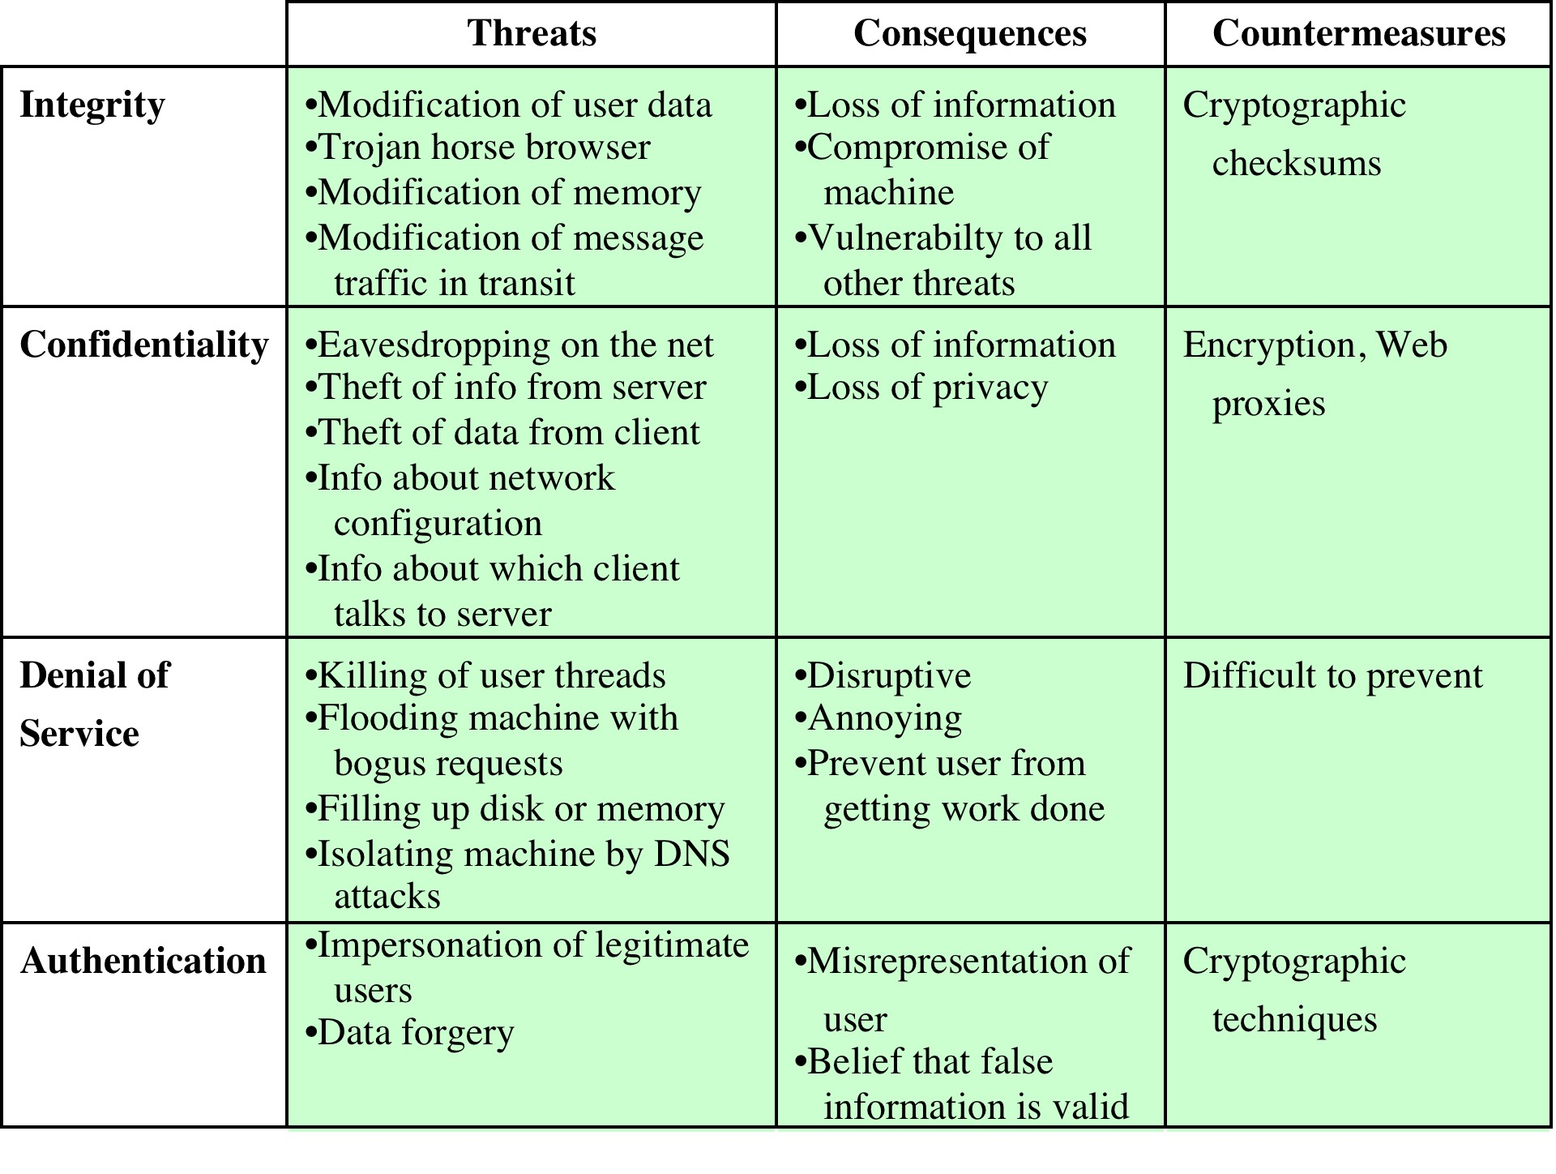
Table 17.1
A Comparison of Threats on the Web

Slide 4
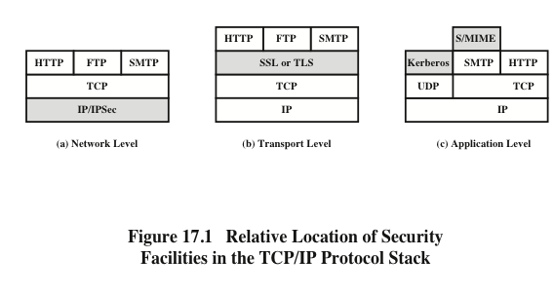

Slide 5






Transport Layer Security (TLS)
Most browsers come
equipped with TLS, and
One of the most widely
used security services
Can be embedded in specific packages
most Web servers have implemented the protocol
Could be provided as part of the underlying protocol suite and therefore be transparent to applications
Defined in RFC 5246
Is an Internet standard that evolved from a commercial protocol known as Secure Sockets Layer (SSL)
Is a general purpose service implemented as a set of protocols that rely on TCP

Slide 6
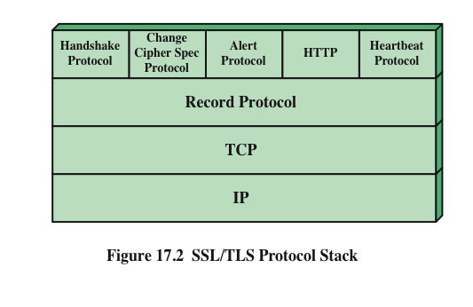

Slide 7




TLS Architecture
Two important TLS concepts are:
TLS
connection
A transport that provides a suitable type of service
For TLS such connections are peer-to-peer relationships
Connections are transient
Every connection is associated with one session
An association between a client and a server
Created by the Handshake Protocol
Define a set of cryptographic security parameters which can be shared among multiple connections
Are used to avoid the expensive negotiation of new security parameters for each connection
TLS session

Slide 8






A session state is defined by the following parameters:
Session
identifier
Peer
certificate
Compression
method
Cipher spec
Master secret
Is resumable
Specifies the bulk data encryption algorithm and a hash algorithm used for MAC calculation; also defines cryptographic attributes such as the hash_size
An arbitrary byte sequence chosen by the server to identify an active or resumable session state
An X509.v3
certificate of the peer; this element of the state may be null
A flag indicating whether the session can be used to initiate new connections
The algorithm used to compress data prior to encryption
48-byte secret shared between the client and the server

Slide 9







A connection state is defined by the following parameters:
Server and client random
Byte sequences that are chosen by the server and client for each connection
When a block cipher in CBC mode is used, an initialization vector (IV) is maintained for each key
This field is first initialized by the TLS Handshake Protocol
The final ciphertext block from each record is preserved for use as the IV with the following record
Initialization vectors
Server write MAC secret
The secret key used in MAC operations on data sent by the server
Client write MAC secret
The secret key used in MAC operations on data sent by the client
Each party maintains separate sequence numbers for transmitted and received messages for each connection
When a party sends or receives a change cipher spec message, the appropriate sequence number is set to zero
Sequence numbers may not exceed 2⁶⁴ - 1
Server write
key
The secret encryption key for data encrypted by the server and decrypted by the client
Sequence numbers
Client write
key
The symmetric encryption key for data encrypted by the client and decrypted by the server

Slide 10





TLS Record Protocol
The TLS Record Protocol provides two services for TLS connections
Confidentiality
Message integrity
The Handshake Protocol defines a shared secret key that is used for conventional encryption of TLS payloads
The Handshake Protocol also defines a shared secret key that is used to form a message authentication code (MAC)

Slide 11
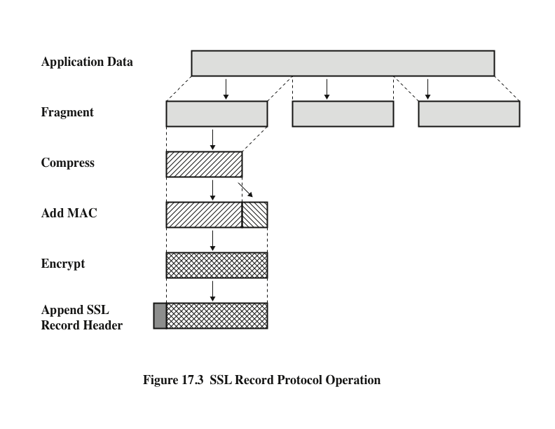
TLS
TLS Record Protocol Operation

Slide 12
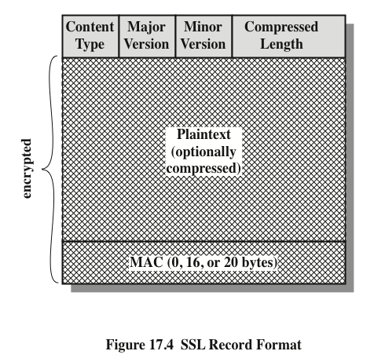
Figure 17.4 TLS Record Format

Slide 13
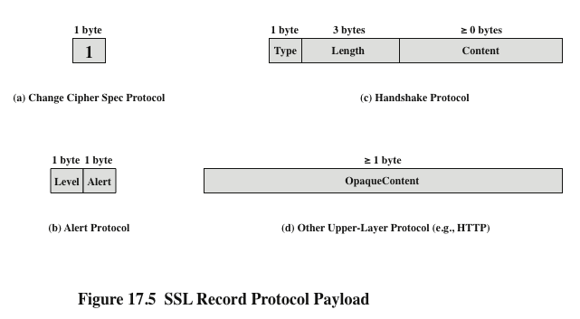
Figure 17.5 TLS Record Protocol Payload

Slide 14
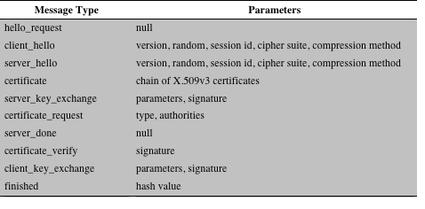
Table 17.2 SSL Handshake Protocol Message Types
Table 17.2 TLS Handshake Protocol Message Types

Slide 15
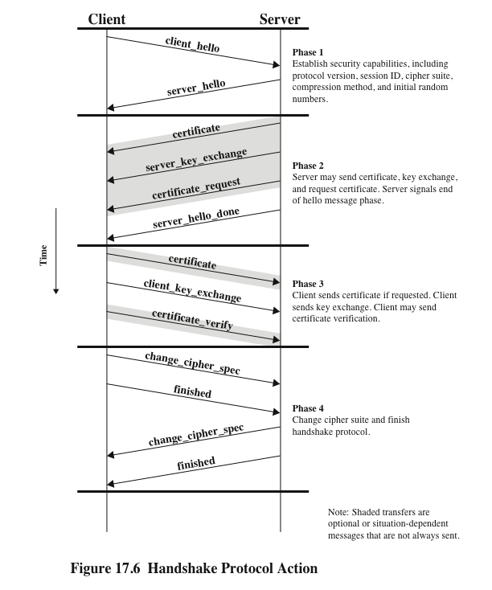

Slide 16
Cryptographic Computations
Two further items are of interest:
The creation of a shared master secret by means of the key exchange
The shared master secret is a one-time 48-byte value generated for this session by means of secure key exchange
The creation is in two stages
First, a pre_master_secret is exchanged
Second, the master_secret is calculated by both parties
The generation of cryptographic parameters from the master secret

Slide 17
Generation of Cryptographic Parameters
CipherSpecs require:
A client write MAC secret
A server write MAC secret
A client write key
A server write key
A client write IV
A server write IV
------Which are generated from the master secret in that order
These parameters are generated from the master secret by hashing the master secret into a sequence of secure bytes of sufficient length for all needed parameters

Slide 18
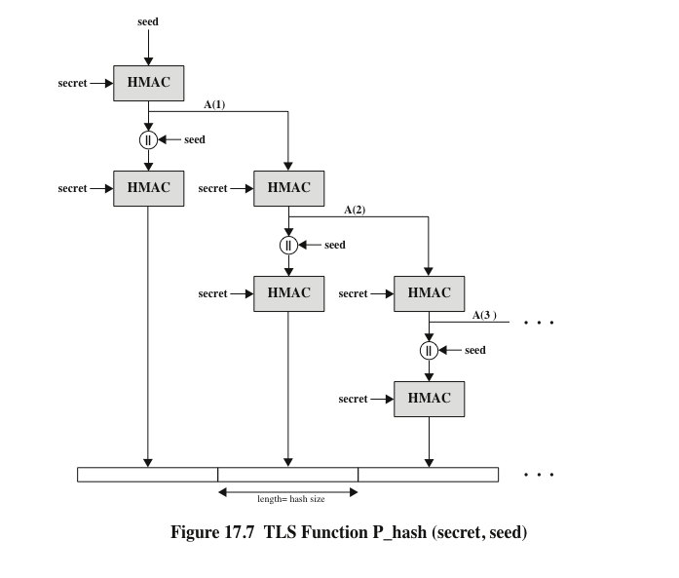

Slide 19
SSL/TLS Attacks
The attacks can be grouped into four general categories:
Attacks on the handshake protocol
Attacks on the record and application data protocols
Attacks on the PKI
Other attacks
The constant back-and-forth between threats and countermeasures determines the evolution of Internet-based protocols

Slide 20
TLSv1.3
Primary aim is to improve the security of TLS
Significant changes from version 1.2 are:
TLSv1.3 removes support for a number of options and functions
Deleted items include:
Compression
Ciphers that do not offer authenticated encryption
Static RSA and DH key exchange
32-bit timestamp as part of the Random parameter in the client_hello
message
Renegotiation
Change Cipher Spec Protocol
RC4
Use of MD5 and SHA-224 hashes with signatures
TLSv1.3 uses Diffie-Hellman or Elleptic Curve Diffie-Hellman for key exchange and does not permit RSA
TLSv1.3 allows for a “1 round trip time” handshake by changing the order of message sent with establishing a secure connection

Slide 21
HTTPS
(HTTP over SSL)
Refers to the combination of HTTP and SSL to implement secure
communication between a Web browser and a Web server
The HTTPS capability is built into all modern Web browsers
A user of a Web browser will see URL addresses that begin with https:// rather
than http://
If HTTPS is specified, port 443 is used, which invokes SSL
Documented in RFC 2818, HTTP Over TLS
There is no fundamental change in using HTTP over either SSL or TLS and both
implementations are referred to as HTTPS
When HTTPS is used, the following elements of the communication are encrypted:
URL of the requested document
Contents of the document
Contents of browser forms
Cookies sent from browser to server and from server to browser
Contents of HTTP header

Slide 22






Connection Initiation
For HTTPS, the agent acting as the HTTP client also acts as the TLS client
There are three levels of awareness of a connection in HTTPS:
At the HTTP level, an HTTP client requests a connection to an HTTP server by sending a connection request to the next lowest layer
Typically the next lowest layer is TCP, but is may also be TLS/SSL
At the level of TLS, a session is established between a TLS client and a TLS server
This session can support one or more connections at any time
The client initiates a connection to the server on the appropriate port and then sends the TLS ClientHello to begin the TLS handshake
When the TLS handshake has finished, the client may then initiate the first HTTP request
A TLS request to establish a connection begins with the establishment of a TCP connection between the TCP entity on the client side and the TCP entity on the server side
All HTTP data is to be sent as TLS application
data

Slide 23
Connection Closure
An HTTP client or server can indicate the closing of a connection by including the line Connection: close in an HTTP record
The closure of an HTTPS connection requires that TLS close the connection with the peer TLS entity on the remote side, which will involve closing the underlying TCP connection
TLS implementations must initiate an exchange of closure alerts before closing a connection
A TLS implementation may, after sending a closure alert, close the connection without waiting for the peer to send its closure alert, generating an “incomplete close”
An unannounced TCP closure could be evidence of some sort of attack so the HTTPS client should issue some sort of security warning when this occurs

Slide 24






Secure Shell (SSH)
A protocol for secure network communications designed to be relatively simple and inexpensive to implement
SSH client and server applications are widely available for most operating systems
Has become the method of choice for remote login and X tunneling
Is rapidly becoming one of the most pervasive applications for encryption technology outside of embedded systems
The initial version, SSH1 was focused on providing a secure remote logon facility to replace TELNET and other remote logon schemes that provided no security
SSH2 fixes a number of security flaws in the original scheme and is documented as a proposed standard in IETF RFCs 4250 through 4256
SSH also provides a more general client/server capability and can be used for such network functions as file transfer and e-mail

Slide 25
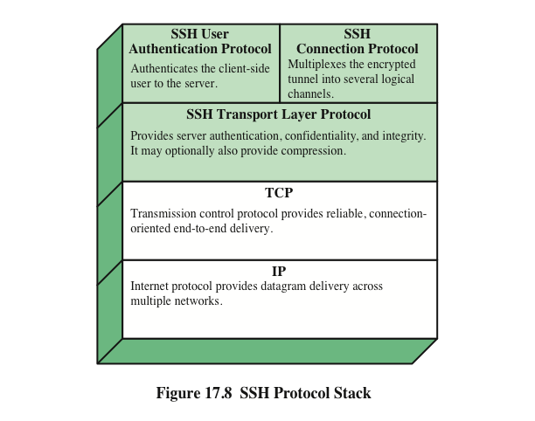

Slide 26
Transport Layer Protocol
Server authentication occurs at the transport layer, based on the server possessing a public/private key pair
A server may have multiple host keys using multiple different asymmetric encryption algorithms
Multiple hosts may share the same host key
The server host key is used during key exchange to authenticate the identity of the host
RFC 4251 dictates two alternative trust models:
The client has a local database that associates each host name with the corresponding public host key
The host name-to-key association is certified by a trusted certification authority (CA); the client only knows the CA root key and can verify the validity of all host keys certified by accepted CAs

Slide 27
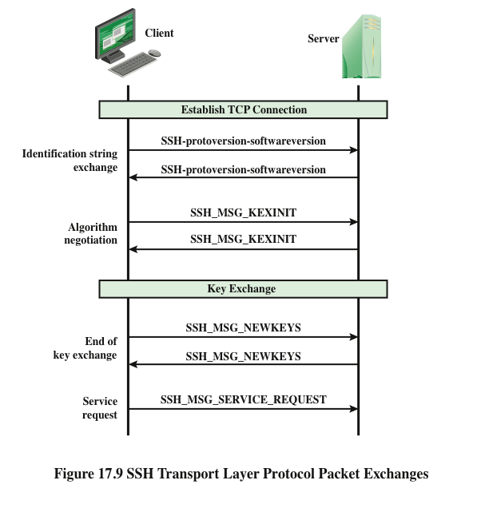

Slide 28
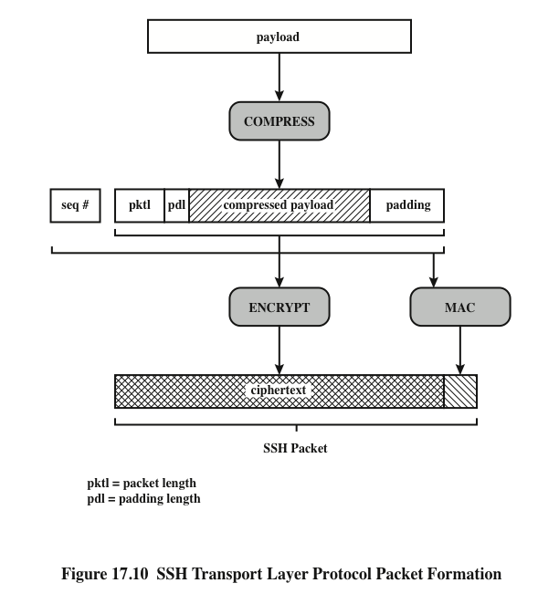

Slide 29

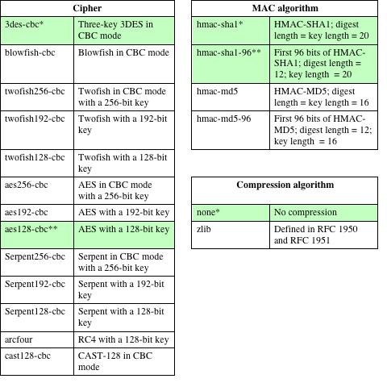
Table
SSH
Transport Layer Cryptographic Algorithms
* = Required
** = Recommended

Slide 30
Authentication Methods
Publickey
The client sends a message to the server that contains the client’s public key, with the message signed by the client’s private key
When the server receives this message, it checks whether the supplied key is acceptable for authentication and, if so, it checks whether the signature is correct
Password
The client sends a message containing a plaintext password, which is
protected by encryption by the Transport Layer Protocol
Hostbased
Authentication is performed on the client’s host rather than the client
itself
This method works by having the client send a signature created with the private key of the client host
Rather than directly verifying the user’s identity, the SSH server verifies the identity of the client host

Slide 31
Connection Protocol
The SSH Connection Protocol runs on top of the SSH Transport Layer Protocol and assumes that a secure authentication connection is in use
The secure authentication connection, referred to as a tunnel, is used
by the Connection Protocol to multiplex a number of logical channels
Channel mechanism
All types of communication using SSH are supported using separate
channels
Either side may open a channel
For each channel, each side associates a unique channel number
Channels are flow controlled using a window mechanism
No data may be sent to a channel until a message is received to
indicate that window space is available
The life of a channel progresses through three stages: opening a channel, data transfer, and closing a channel

Slide 32
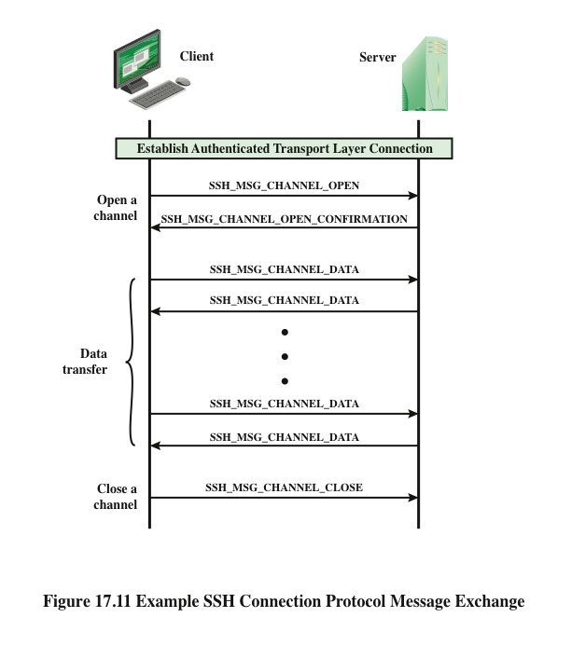

Slide 33
Channel Types
Four channel types are recognized in the SSH Connection Protocol specification
Session
The remote execution of a program
The program may be a shell, an application such as file transfer or e-mail, a system command, or some built-in subsystem
Once a session channel is opened, subsequent requests are used to start the remote program
X11
Refers to the X Window System, a computer software system and network protocol that provides a graphical user interface (GUI) for networked computers
X allows applications to run on a network server but to be displayed on a desktop
machine
Forwarded-tcpip
Remote port forwarding
Direct-tcpip
Local port forwarding

Slide 34
Port Forwarding
One of the most useful features of SSH
Provides the ability to convert any insecure TCP connection into a secure SSH connection (also referred to as SSH tunneling)
Incoming TCP traffic is delivered to the appropriate application on the basis of the port number (a port is an identifier of a user of TCP)
An application may employ multiple port numbers

Slide 35
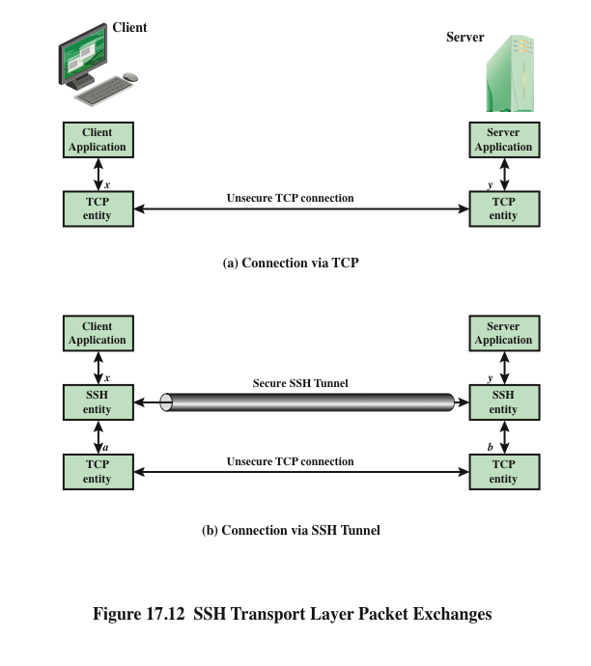

Slide 36


Summary
Web security considerations
Web security threats
Web traffic security
approaches
Secure sockets layer
SSL architecture
SSL record protocol
Change cipher spec protocol
Alert protocol
Handshake protocol
Cryptographic computations
Heartbeat protocol
SSL/TLS attacks
TLSv1.3
Secure shell (SSH)
Transport layer protocol
User authentication protocol
Communication protocol
HTTPS
Connection initiation
Connection closure

